Slide 1
servlets

Slide 2
servlets
Servlet technology is used to create a web application (resides at server side and generates a dynamic web page).
Servlet technology is robust and scalable because of java language. Before Servlet, CGI (Common Gateway Interface) scripting language was common as a server-side programming language. However, there were many disadvantages to this technology. We have discussed these disadvantages below.
There are many interfaces and classes in the Servlet API such as Servlet, GenericServlet, HttpServlet, ServletRequest, ServletResponse, etc.

Slide 3
What is a Servlet?
Servlet can be described in many ways, depending on the context.
Servlet is a technology which is used to create a web application.
Servlet is an API that provides many interfaces and classes including documentation.
Servlet is an interface that must be implemented for creating any Servlet.
Servlet is a class that extends the capabilities of the servers and responds to the incoming requests. It can respond to any requests.
Servlet is a web component that is deployed on the server to create a dynamic web page.

Slide 4
What is a web application?
A web application is an application accessible from the web. A web application is composed of web components like Servlet, JSP, Filter, etc. and other elements such as HTML, CSS, and JavaScript. The web components typically execute in Web Server and respond to the HTTP request.

Slide 5
CGI (Common Gateway Interface)
CGI technology enables the web server to call an external program and pass HTTP request information to the external program to process the request. For each request, it starts a new process.

Slide 6
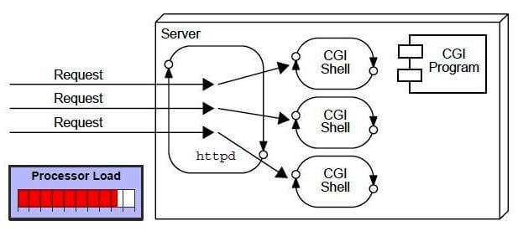

Slide 7
Disadvantages of CGI
There are many problems in CGI technology:
If the number of clients increases, it takes more time for sending the response.
For each request, it starts a process, and the web server is limited to start processes.
It uses platform dependent language e.g. C, C++, perl.

Slide 8
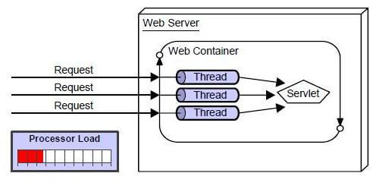
Advantages of Servlet

Slide 9
There are many advantages of Servlet over CGI. The web container creates threads for handling the multiple requests to the Servlet. Threads have many benefits over the Processes such as they share a common memory area, lightweight, cost of communication between the threads are low. The advantages of Servlet are as follows:
Better performance: because it creates a thread for each request, not process.
Portability: because it uses Java language.
Robust: JVM manages Servlets, so we don't need to worry about the memory leak, garbage collection, etc.
Secure: because it uses java language.

Slide 10
The HTTP request methods are:
HTTP Request | Description
GET | Asks to get the resource at the requested URL.
POST | Asks the server to accept the body info attached. It is like GET request with extra info sent with the request.
HEAD | Asks for only the header part of whatever a GET would return. Just like GET but with no body.
TRACE | Asks for the loopback of the request message, for testing or troubleshooting.
PUT | Says to put the enclosed info (the body) at the requested URL.
DELETE | Says to delete the resource at the requested URL.
OPTIONS | Asks for a list of the HTTP methods to which the thing at the request URL can respond

Slide 11
Servlet life cycle
The web container maintains the life cycle of a servlet instance. Let's see the life cycle of the servlet:
Servlet class is loaded.
Servlet instance is created.
init method is invoked.
service method is invoked.
destroy method is invoked.

Slide 12
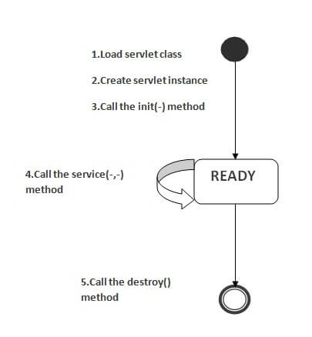

Slide 13
Servlet class is loaded
The classloader is responsible to load the servlet class. The servlet class is loaded when the first request for the servlet is received by the web container.
Servlet instance is created
The web container creates the instance of a servlet after loading the servlet class. The servlet instance is created only once in the servlet life cycle.

Slide 14
init method is invoked
The web container calls the init method only once after creating the servlet instance. The init method is used to initialize the servlet. It is the life cycle method of the javax.servlet.Servlet interface.
Syntax of the init method is given below:
public void init(ServletConfig config) throws ServletException

Slide 15
service method is invoked
The web container calls the service method each time when request for the servlet is received. If servlet is not initialized, it follows the first three steps as described above then calls the service method. If servlet is initialized, it calls the service method. Notice that servlet is initialized only once.
The syntax of the service method of the Servlet interface is given below:
public void service(ServletRequest request, ServletResponse response) throws ServletException, IOException

Slide 16
destroy method is invoked
The web container calls the destroy method before removing the servlet instance from the service. It gives the servlet an opportunity to clean up any resource for example memory, thread etc.
The syntax of the destroy method of the Servlet interface is given below:
public void destroy()

Slide 17
Servlet API
The javax.servlet and javax.servlet.http packages represent interfaces and classes for servlet api.
The javax.servlet package contains many interfaces and classes that are used by the servlet or web container. These are not specific to any protocol.
The javax.servlet.http package contains interfaces and classes that are responsible for http requests only.

Slide 18
Interfaces in javax.servlet package
There are many interfaces in javax.servlet package. They are as follows:
Servlet
ServletRequest
ServletResponse
RequestDispatcher
ServletConfig
ServletContext
SingleThreadModel
Filter
FilterConfig
FilterChain
ServletRequestListener
ServletRequestAttributeListener
ServletContextListener
ServletContextAttributeListener

Slide 19
Classes in javax.servlet package
There are many classes in javax.servlet package. They are as follows:
GenericServlet
ServletInputStream
ServletOutputStream
ServletRequestWrapper
ServletResponseWrapper
ServletRequestEvent
ServletContextEvent
ServletRequestAttributeEvent
ServletContextAttributeEvent
ServletException
UnavailableException

Slide 20
Interfaces in javax.servlet.http package
There are many interfaces in javax.servlet.http package. They are as follows:
HttpServletRequest
HttpServletResponse
HttpSession
HttpSessionListener
HttpSessionAttributeListener
HttpSessionBindingListener
HttpSessionActivationListener
HttpSessionContext (deprecated now

Slide 21
Classes in javax.servlet.http package
There are many classes in javax.servlet.http package. They are as follows:
HttpServlet
Cookie
HttpServletRequestWrapper
HttpServletResponseWrapper
HttpSessionEvent
HttpSessionBindingEvent
HttpUtils (deprecated now

Slide 22
Servlet Interface
Servlet interface provides common behavior to all the servlets. Servlet interface defines methods that all servlets must implement.
Servlet interface needs to be implemented for creating any servlet (either directly or indirectly). It provides 3 life cycle methods that are used to initialize the servlet, to service the requests, and to destroy the servlet and 2 non-life cycle methods.

Slide 23
Method | Description
public void init(ServletConfig config) | initializes the servlet. It is the life cycle method of servlet and invoked by the web container only once.
public void service(ServletRequest request,ServletResponse response) | provides response for the incoming request. It is invoked at each request by the web container.
public void destroy() | is invoked only once and indicates that servlet is being destroyed.
public ServletConfig getServletConfig() | returns the object of ServletConfig.
public String getServletInfo() | returns information about servlet such as writer, copyright, version etc.

Slide 24
GenericServlet
GenericServlet classimplements Servlet, ServletConfig and Serializable interfaces. It provides the implementation of all the methods of these interfaces except the service method.
GenericServlet class can handle any type of request so it is protocol-independent.
You may create a generic servlet by inheriting the GenericServlet class and providing the implementation of the service method.

Slide 25
Methods of GenericServlet class
public void init(ServletConfig config) is used to initialize the servlet.
public abstract void service(ServletRequest request, ServletResponse response) provides service for the incoming request. It is invoked at each time when user requests for a servlet.
public void destroy() is invoked only once throughout the life cycle and indicates that servlet is being destroyed.
public ServletConfig getServletConfig() returns the object of ServletConfig.
public String getServletInfo() returns information about servlet such as writer, copyright, version etc.
public void init() it is a convenient method for the servlet programmers, now there is no need to call super.init(config)

Slide 26
public ServletContext getServletContext() returns the object of ServletContext.
public String getInitParameter(String name) returns the parameter value for the given parameter name.
public Enumeration getInitParameterNames() returns all the parameters defined in the web.xml file.
public String getServletName() returns the name of the servlet object.
public void log(String msg) writes the given message in the servlet log file.
public void log(String msg,Throwable t) writes the explanatory message in the servlet log file and a stack trace.

Slide 27
HttpServlet class
The HttpServlet class extends the GenericServlet class and implements Serializable interface. It provides http specific methods such as doGet, doPost, doHead, doTrace etc.

Slide 28
Methods of HttpServlet class
public void service(ServletRequest req,ServletResponse res) dispatches the request to the protected service method by converting the request and response object into http type.
protected void service(HttpServletRequest req, HttpServletResponse res) receives the request from the service method, and dispatches the request to the doXXX() method depending on the incoming http request type.
protected void doGet(HttpServletRequest req, HttpServletResponse res) handles the GET request. It is invoked by the web container.
protected void doPost(HttpServletRequest req, HttpServletResponse res) handles the POST request. It is invoked by the web container.
protected void doHead(HttpServletRequest req, HttpServletResponse res) handles the HEAD request. It is invoked by the web container.

Slide 29
protected void doOptions(HttpServletRequest req, HttpServletResponse res) handles the OPTIONS request. It is invoked by the web container.
protected void doPut(HttpServletRequest req, HttpServletResponse res) handles the PUT request. It is invoked by the web container.
protected void doTrace(HttpServletRequest req, HttpServletResponse res) handles the TRACE request. It is invoked by the web container.
protected void doDelete(HttpServletRequest req, HttpServletResponse res) handles the DELETE request. It is invoked by the web container.
protected long getLastModified(HttpServletRequest req) returns the time when HttpServletRequest was last modified since midnight January 1, 1970 GMT.

Slide 30
ServletRequest Interface
An object of ServletRequest is used to provide the client request information to a servlet such as content type, content length, parameter names and values, header informations, attributes etc.

Slide 31
Methods of ServletRequest interface
Method | Description
public String getParameter(String name) | is used to obtain the value of a parameter by name.
public String[] getParameterValues(String name) | returns an array of String containing all values of given parameter name. It is mainly used to obtain values of a Multi select list box.
java.util.Enumeration getParameterNames() | returns an enumeration of all of the request parameter names.
public int getContentLength() | Returns the size of the request entity data, or -1 if not known.
public String getCharacterEncoding() | Returns the character set encoding for the input of this request.

Slide 32
public String getContentType() | Returns the Internet Media Type of the request entity data, or null if not known.
public ServletInputStream getInputStream() throws IOException | Returns an input stream for reading binary data in the request body.
public abstract String getServerName() | Returns the host name of the server that received the request.
public int getServerPort() | Returns the port number on which this request was received.

Slide 33
Example of ServletRequest to display the name of the user
<form action="welcome" method="get">
Enter your name<input type="text" name="name"><br>
<input type="submit" value="login">
</form>

Slide 34
import javax.servlet.http.*;
import javax.servlet.*;
import java.io.*;
public class DemoServ extends HttpServlet{
public void doGet(HttpServletRequest req,HttpServletResponse res)
throws ServletException,IOException
{
res.setContentType("text/html");
PrintWriter pw=res.getWriter();
String name=req.getParameter("name");//will return value
pw.println("Welcome "+name);
pw.close();
}}

Slide 35
Methods of ServletResponse Interface
public PrintWriter getWriter() : This method returns a PrintWriter object that can send character text to the client.
public ServletOutputStream getOutputStream() : This method returns a ServletOutputStream suitable for writing binary data in the response.
public String getCharacterEncoding() : This method returns the name of the MIME charset used.

Slide 36
public void setContentType(String type) : Sets the content type of the response being sent as response.
public int getBufferSize() : This method returns the actual buffer size used for the response. If no buffering is used, this method returns 0.
public void flushBuffer() : Forces any content in the buffer to be written to the client.

Slide 37
public void setLocale(Locale loc) : This method sets the locale of the response, if the response has not been committed yet.
public boolean isCommitted(): This method returns a boolean indicating if the response has been committed.
public void reset() : Clears the data of the buffer along with the headers and status code.

Slide 38
RequestDispatcher in Servlet
The RequestDispatcher interface provides the facility of dispatching the request to another resource it may be html, servlet or jsp. This interface can also be used to include the content of another resource also. It is one of the way of servlet collaboration.
There are two methods defined in the RequestDispatcher interface.

Slide 39
Methods of RequestDispatcher interface
The RequestDispatcher interface provides two methods. They are:
public void forward(ServletRequest request,ServletResponse response)throws ServletException,java.io.IOException: Forwards a request from a servlet to another resource (servlet, JSP file, or HTML file) on the server.
public void include(ServletRequest request,ServletResponse response)throws ServletException,java.io.IOException: Includes the content of a resource (servlet, JSP page, or HTML file) in the response.

Slide 40
The sendRedirect() methodof HttpServletResponse interface can be used to redirect response to another resource, it may be servlet, jsp or html file.
It accepts relative as well as absolute URL.
It works at client side because it uses the url bar of the browser to make another request. So, it can work inside and outside the server.

Slide 41
Difference between forward() and sendRedirect() method
forward() method | sendRedirect() method
The forward() method works at server side. | The sendRedirect() method works at client side.
It sends the same request and response objects to another servlet. | It always sends a new request.
It can work within the server only. | It can be used within and outside the server.
Example: request.getRequestDispacher("servlet2").forward(request,response); | Example: response.sendRedirect("servlet2");

Slide 42
ServletConfig Interface
An object of ServletConfig is created by the web container for each servlet. This object can be used to get configuration information from web.xml file.
If the configuration information is modified from the web.xml file, we don't need to change the servlet. So it is easier to manage the web application if any specific content is modified from time to time.

Slide 43
Advantage of ServletConfig
The core advantage of ServletConfig is that you don't need to edit the servlet file if information is modified from the web.xml file.

Slide 44
Methods of ServletConfig interface
public String getInitParameter(String name):Returns the parameter value for the specified parameter name.
public Enumeration getInitParameterNames():Returns an enumeration of all the initialization parameter names.
public String getServletName():Returns the name of the servlet.
public ServletContext getServletContext():Returns an object of ServletContext

Slide 45
Session Tracking in Servlets
Session simply means a particular interval of time.
Session Tracking is a way to maintain state (data) of an user. It is also known as session management in servlet.
Http protocol is a stateless so we need to maintain state using session tracking techniques. Each time user requests to the server, server treats the request as the new request. So we need to maintain the state of an user to recognize to particular user.
HTTP is stateless that means each request is considered as the new request. It is shown in the figure given below:

Slide 46
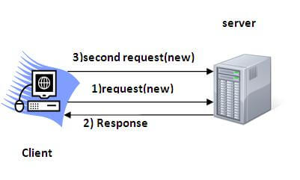

Slide 47
There are four techniques used in Session tracking:
Cookies
Hidden Form Field
URL Rewriting
HttpSession

Slide 48
COOKIES
A cookie is a small piece of information that is persisted between the multiple client requests.
A cookie has a name, a single value, and optional attributes such as a comment, path and domain qualifiers, a maximum age, and a version number.

Slide 49
Advantage of Cookies
Simplest technique of maintaining the state.
Cookies are maintained at client side.
Disadvantage of Cookies
It will not work if cookie is disabled from the browser.
Only textual information can be set in Cookie object.

Slide 50
METHODS
public void addCookie(Cookie ck):method of HttpServletResponse interface is used to add cookie in response object. 2. public Cookie[] getCookies():method of HttpServletRequest interface is used to return all the cookies from the browser.

Slide 51
Cookie ck=new Cookie("user","sonoo jaiswal");//creating cookie object
response.addCookie(ck);//adding cookie in the response

Slide 52
HIDDEN FORM FIELDS
In case of Hidden Form Field a hidden (invisible) textfield is used for maintaining the state of an user.
In such case, we store the information in the hidden field and get it from another servlet. This approach is better if we have to submit form in all the pages and we don't want to depend on the browser.
Let's see the code to store value in hidden field.

Slide 53
<input type="hidden" name="uname" value="Vimal Jaiswal">
Real application of hidden form field
It is widely used in comment form of a website. In such case, we store page id or page name in the hidden field so that each page can be uniquely identified

Slide 54
URL REWRITING
In URL rewriting, we append a token or identifier to the URL of the next Servlet or the next resource. We can send parameter name/value pairs using the following format:
url?name1=value1&name2=value2&??
A name and a value is separated using an equal = sign, a parameter name/value pair is separated from another parameter using the ampersand(&). When the user clicks the hyperlink, the parameter name/value pairs will be passed to the server. From a Servlet, we can use getParameter() method to obtain a parameter value.

Slide 55
HttpSession interface
In such case, container creates a session id for each user. The container uses this id to identify the particular user. An object of HttpSession can be used to perform two tasks:
bind objects
view and manipulate information about a session, such as the session identifier, creation time, and last accessed time.

Slide 56
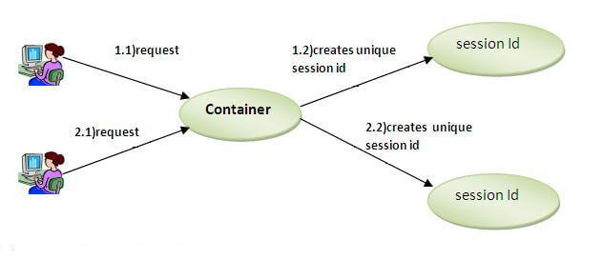

Slide 57
How to get the HttpSession object ?
The HttpServletRequest interface provides two methods to get the object of HttpSession:
public HttpSession getSession():Returns the current session associated with this request, or if the request does not have a session, creates one.
public HttpSession getSession(boolean create):Returns the current HttpSession associated with this request or, if there is no current session and create is true, returns a new session.

Slide 58
Commonly used methods of HttpSession interface
public String getId():Returns a string containing the unique identifier value.
public long getCreationTime():Returns the time when this session was created, measured in milliseconds since midnight January 1, 1970 GMT.
public long getLastAccessedTime():Returns the last time the client sent a request associated with this session, as the number of milliseconds since midnight January 1, 1970 GMT.
public void invalidate():Invalidates this session then unbinds any objects bound to it.

